Slide 1
Practica Netrom
Student: Lascau Ionut Sebastian CEN 3.2A

Slide 2
Short description of the application
Influencers - a web solution that allows posting articles. Readers can vote each article and the vote will score for the author.

Slide 3
Technologies used
The application was developed and tested on IIS EXPRESS as a web server and Google Chrome as a web browser.
Microsoft SqlServer Express
Microsoft Sql Server Management
Visual Studio Community 2019 as IDE
.NetCore 3.1

Slide 4
Functional requirements
Users see on the first page the snippet of the posted articles in the descending order of posting and clicking on an article will show the entire article and it should display the nickname of the author.
The article list page will show for each article the title, a limited number of characters from the text, the nickname of the author and the date.
Voting an article should be allowed only once from a computer and the score will be counted for the author. The solution will not require login for readers nor authors.
A top menu should be shown to allow adding a new article or visualizing the ranking of the influencers.
An article should have a title, content and tags.

Slide 5
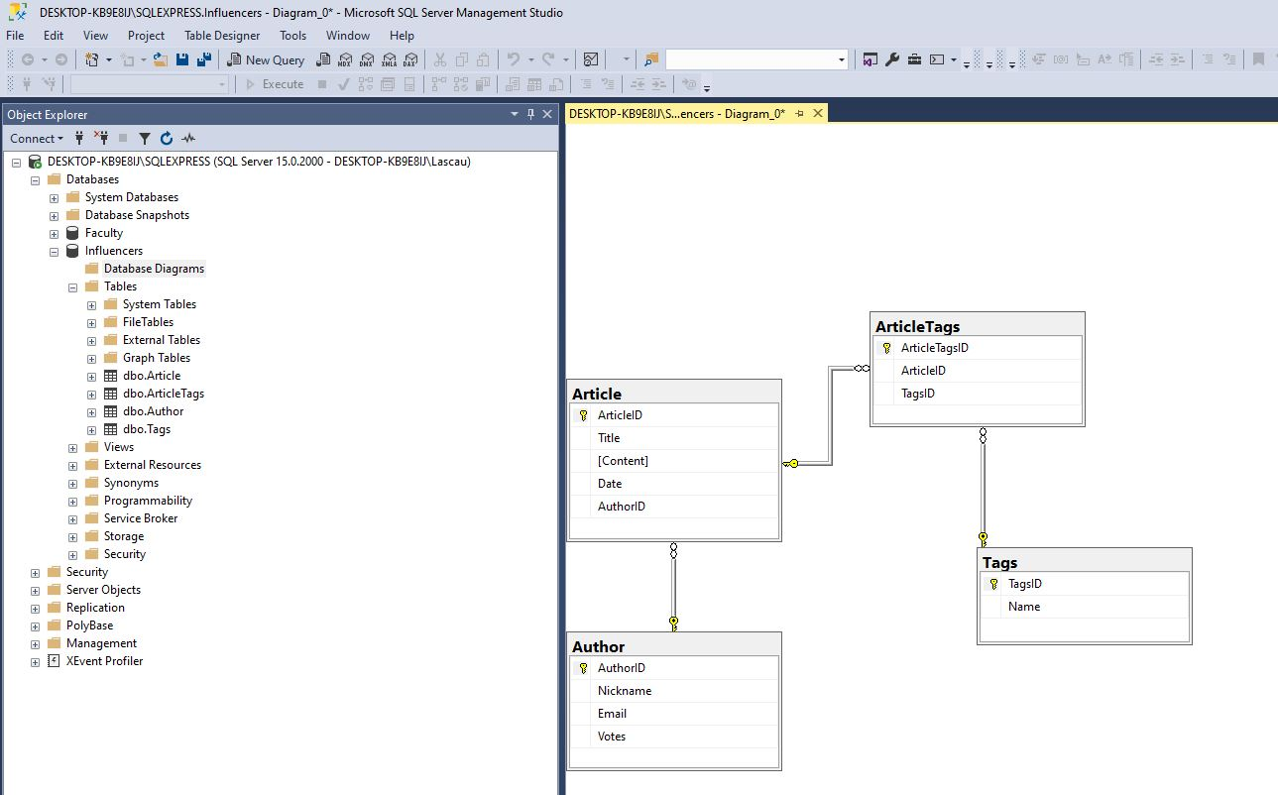
Database structure

Slide 6
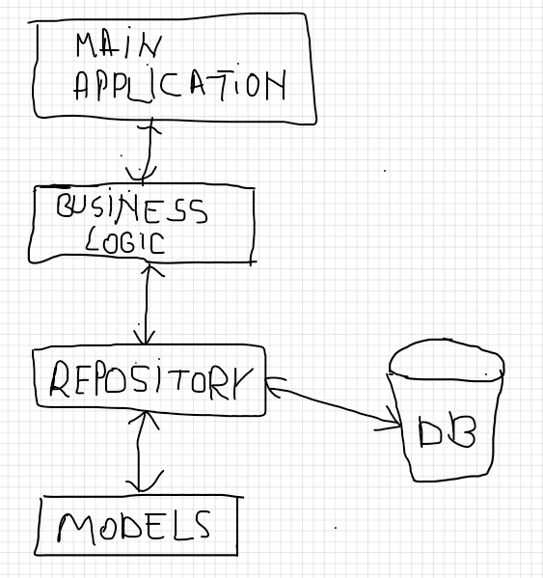
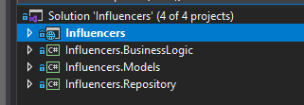
Project arhitecture

Slide 7
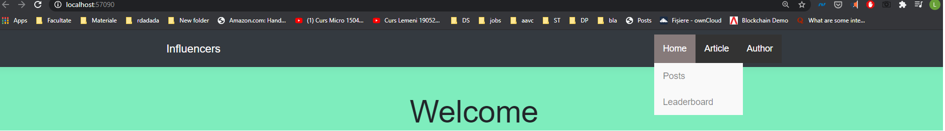
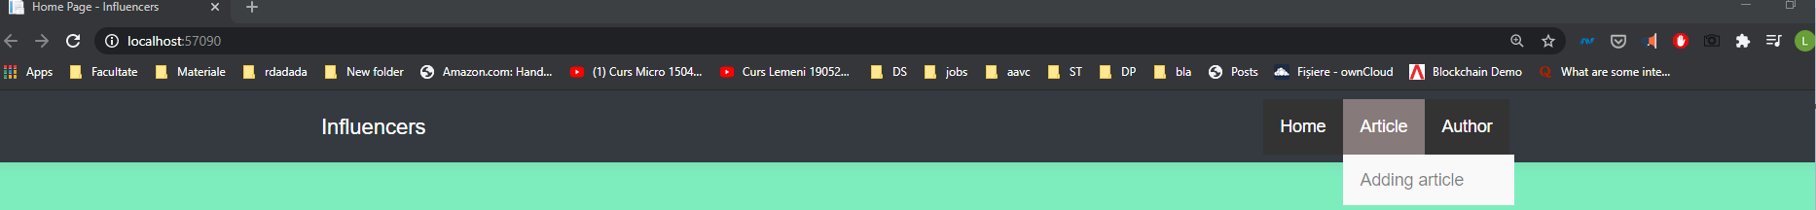
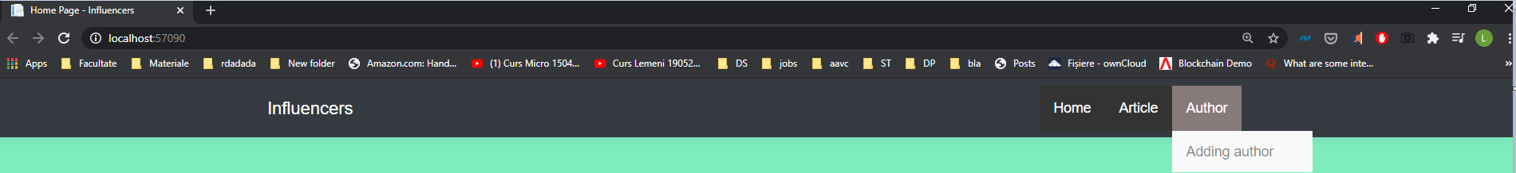
Navigation bars

Slide 8
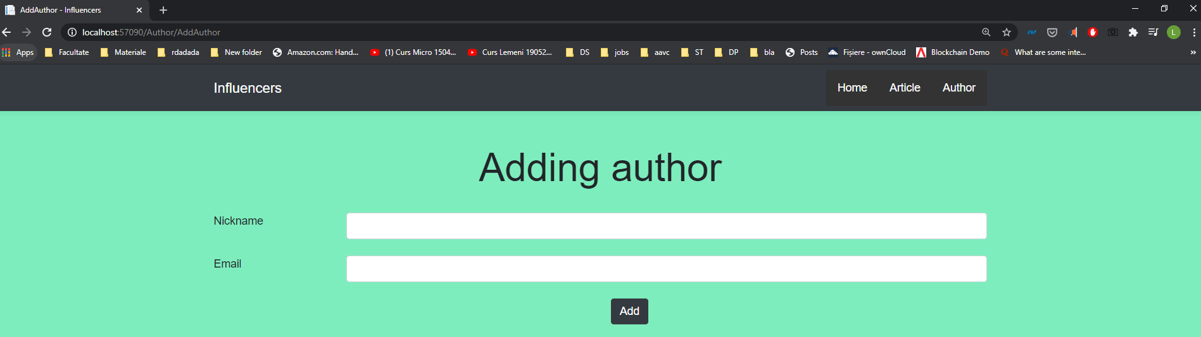
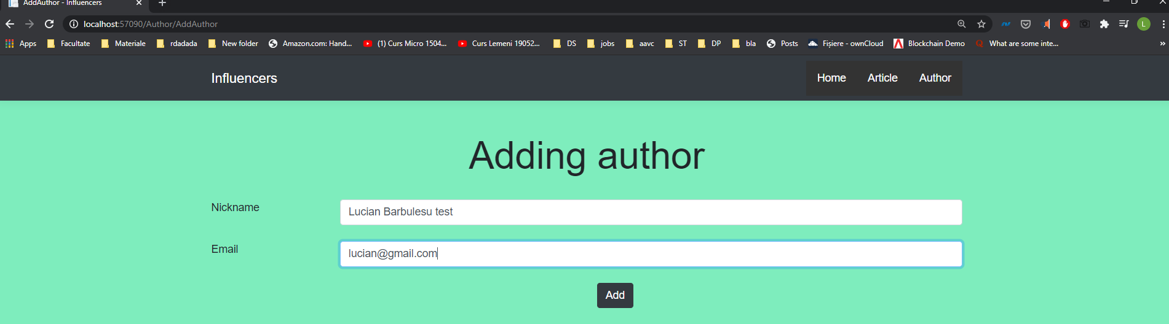
Adding author

Slide 9
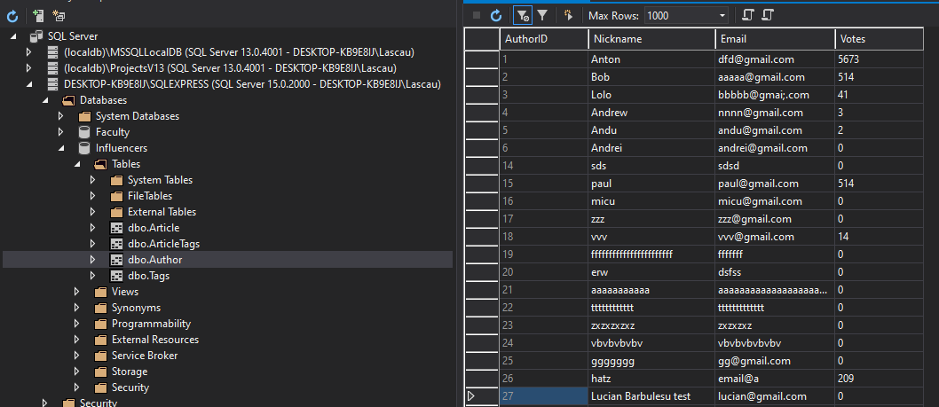
Testing the functionality

Slide 10
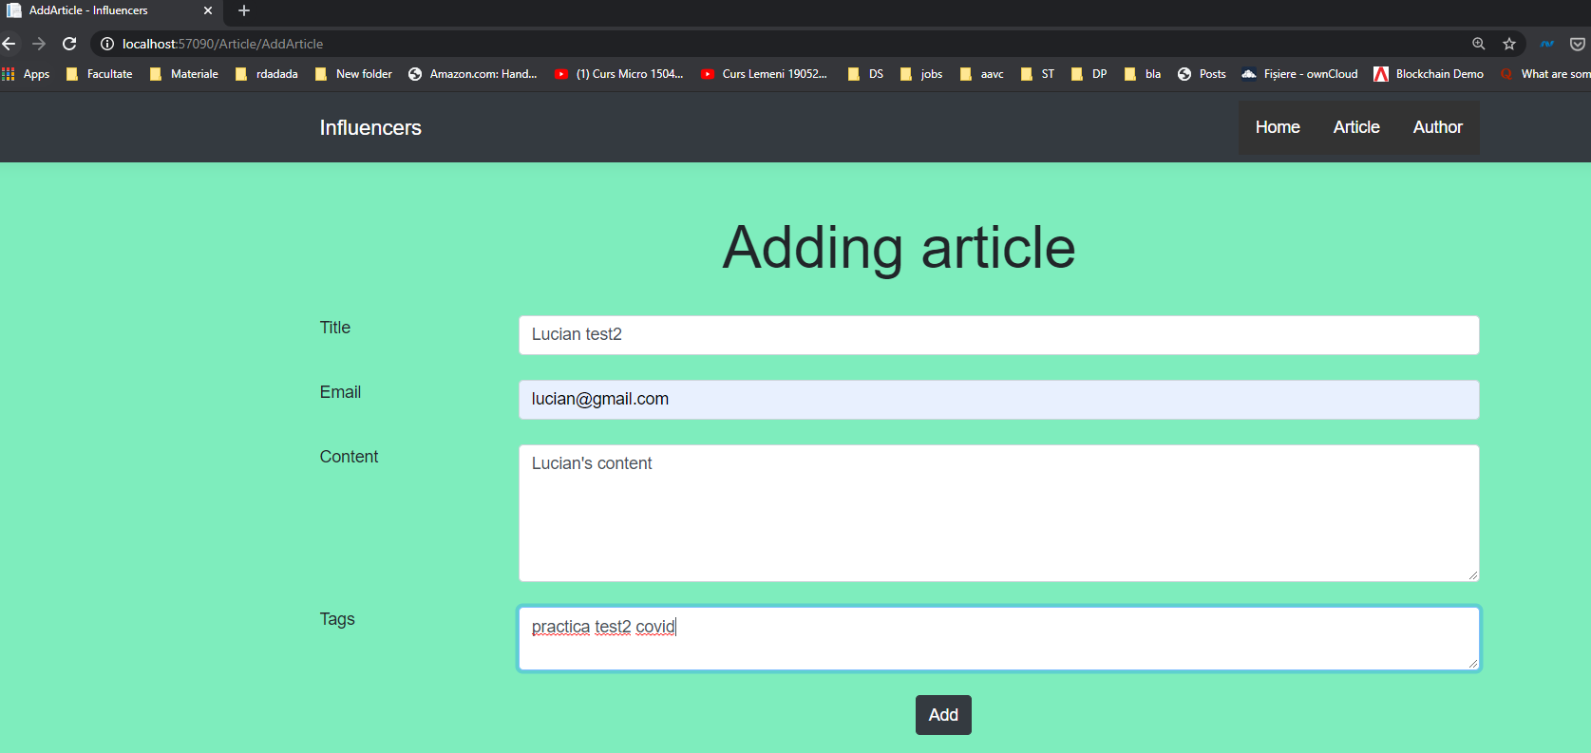
Adding Article

Slide 11
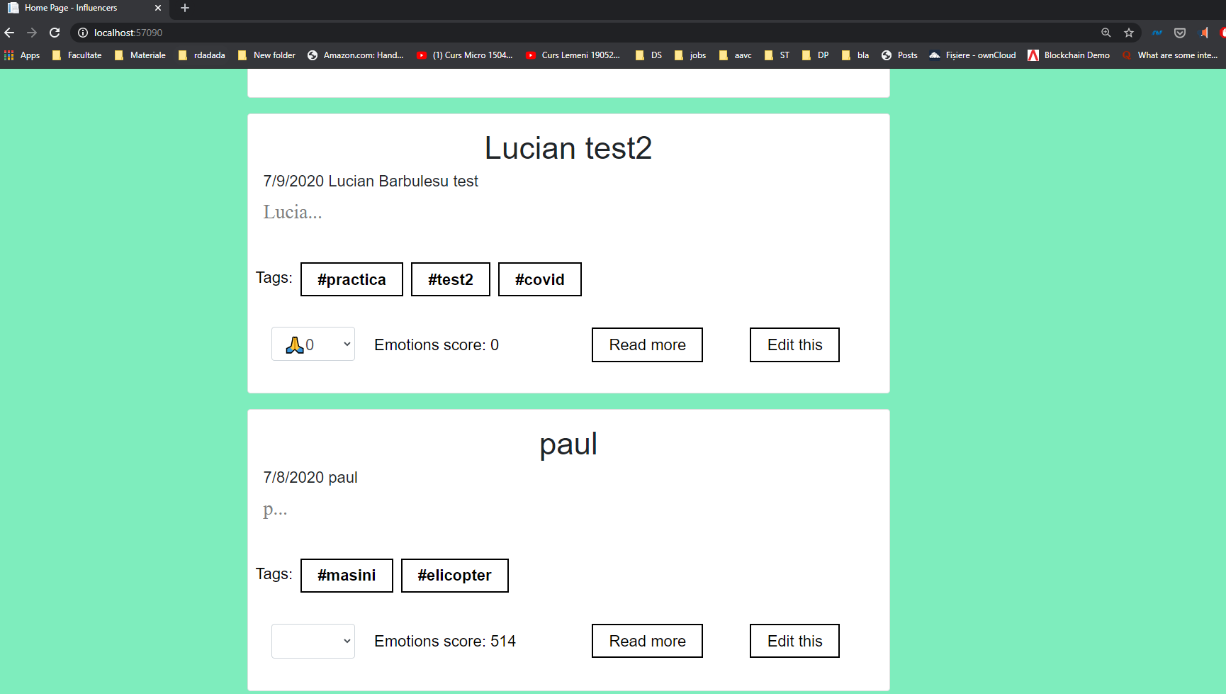
Testing functionality

Slide 12
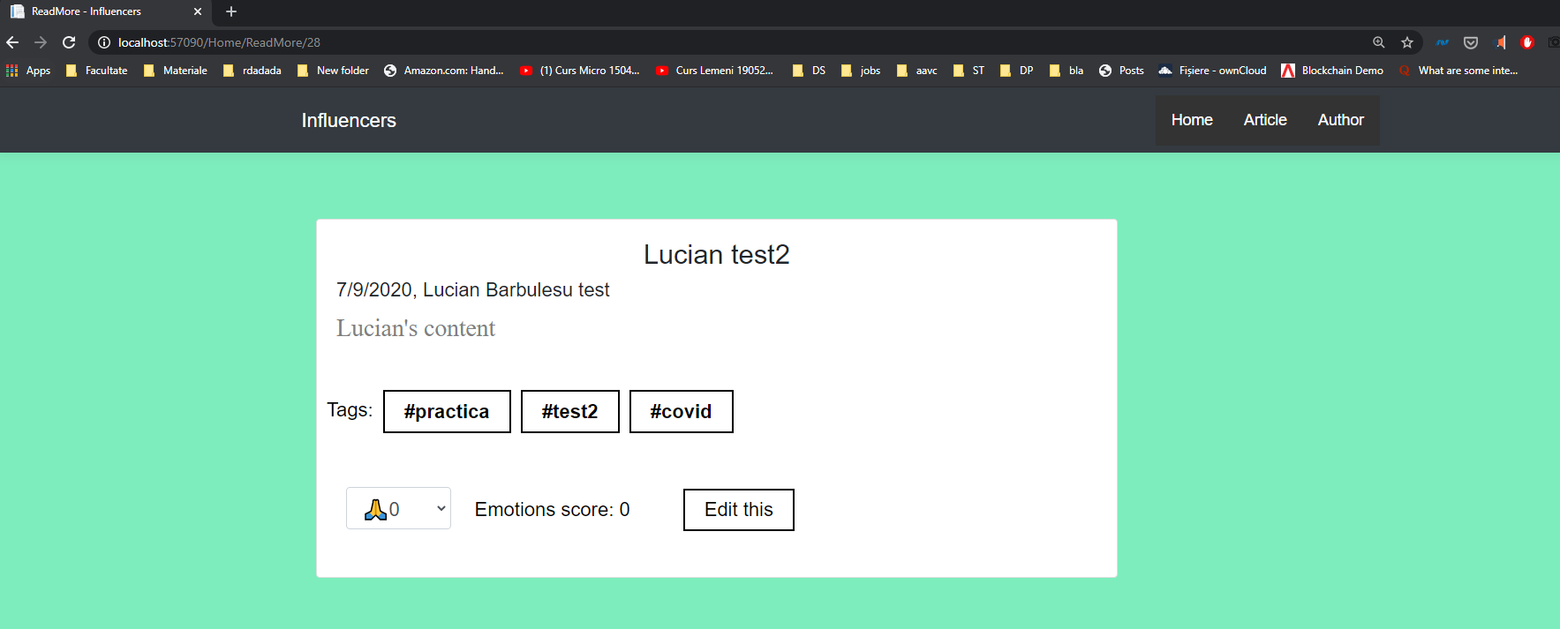
Read more

Slide 13
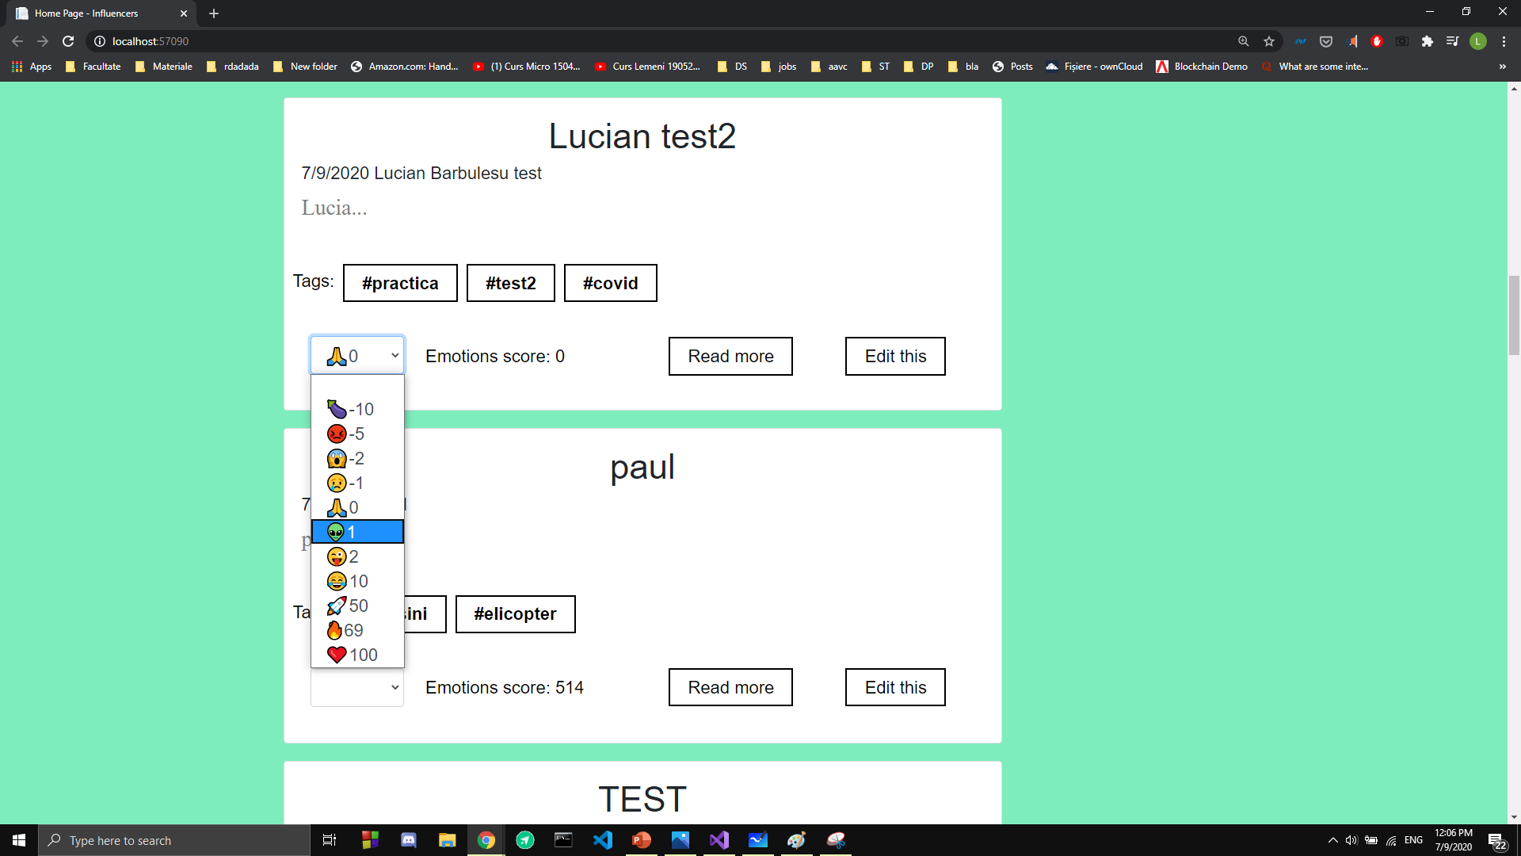
Voting The application hasn’t validation and anyone can vote. You can vote with different emojis but only once per emoji

Slide 14
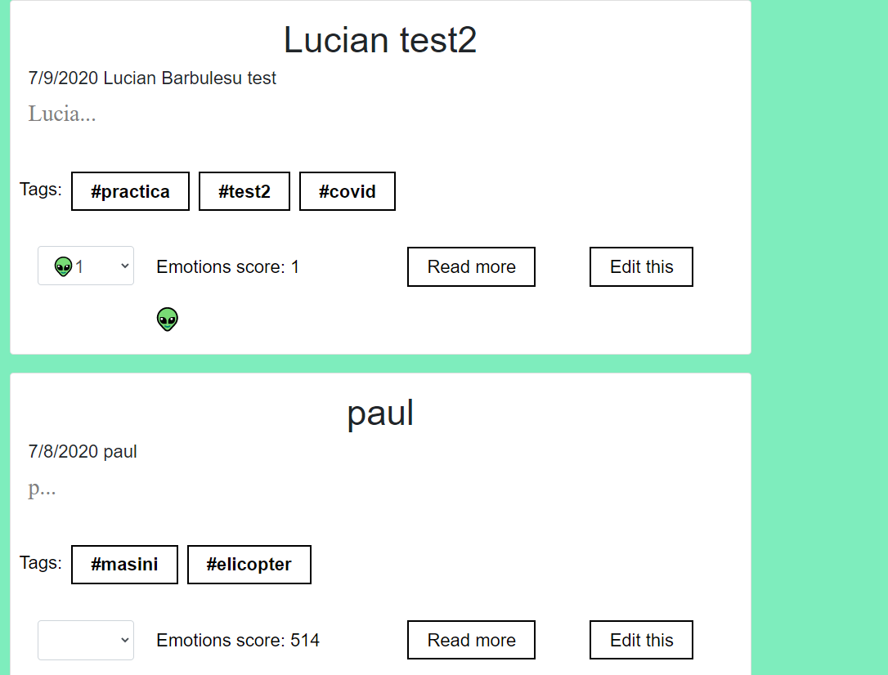
If you vote a post from preview posts page it appears both in preview posts and in read more and vice-versa.

Slide 15
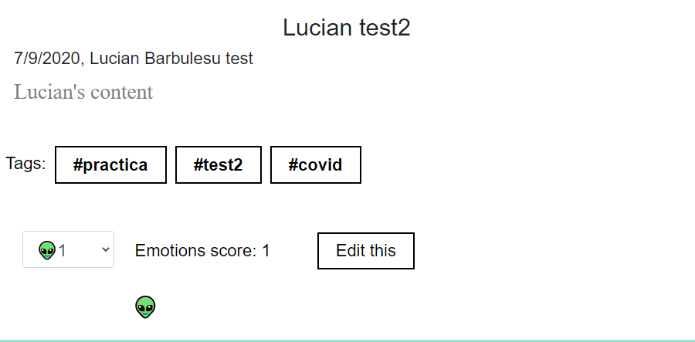

Slide 16
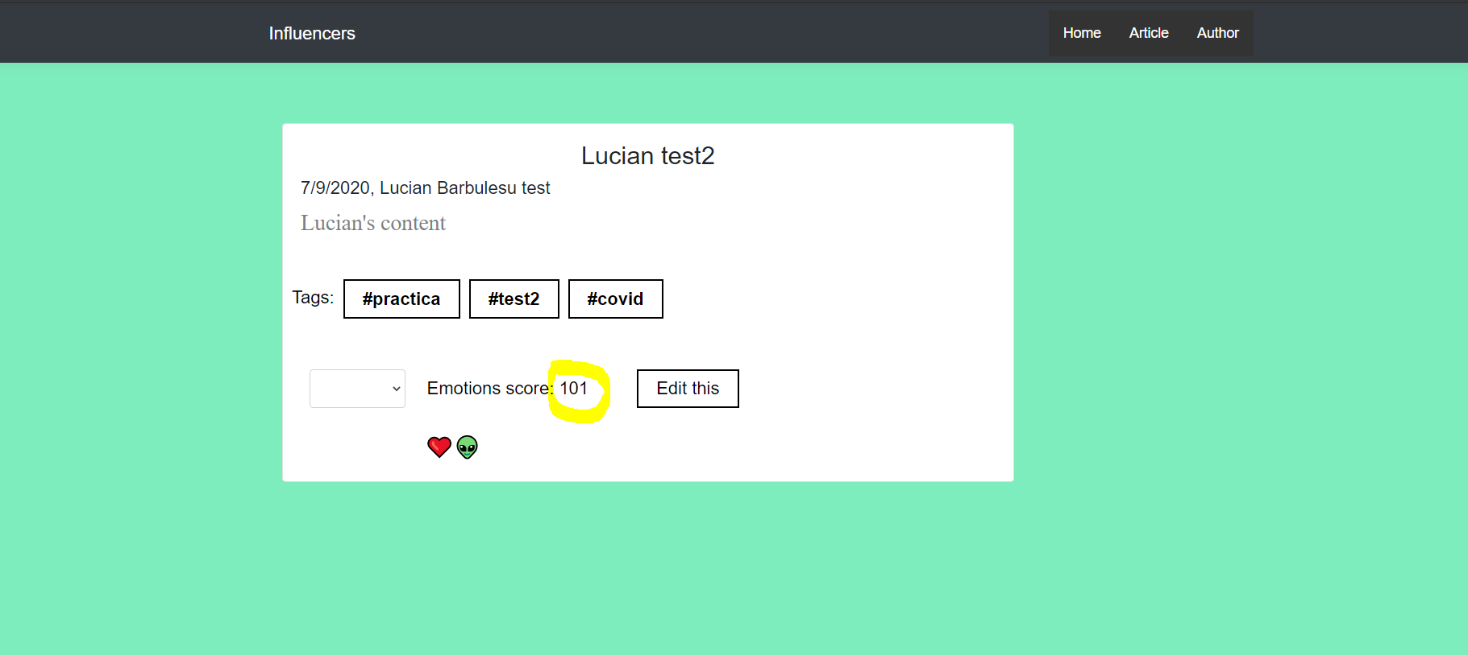
I forgot to mention that emotions score is updated corresponding to emoji’s points

Slide 17
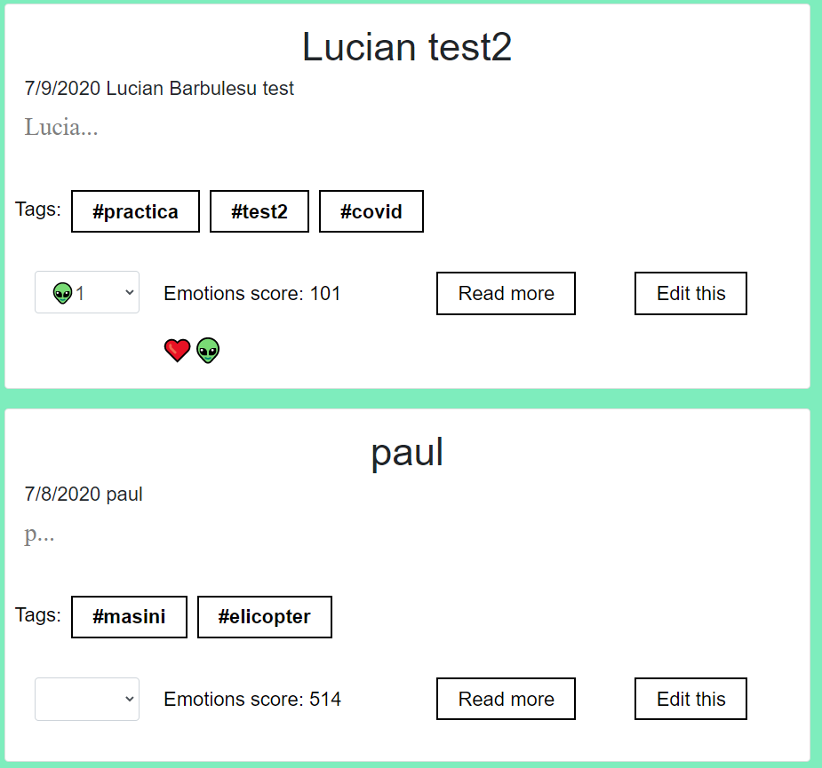
The Heart emoji is still remaining in preview posts. You can undo the vote by clicking on the emoji.

Slide 18
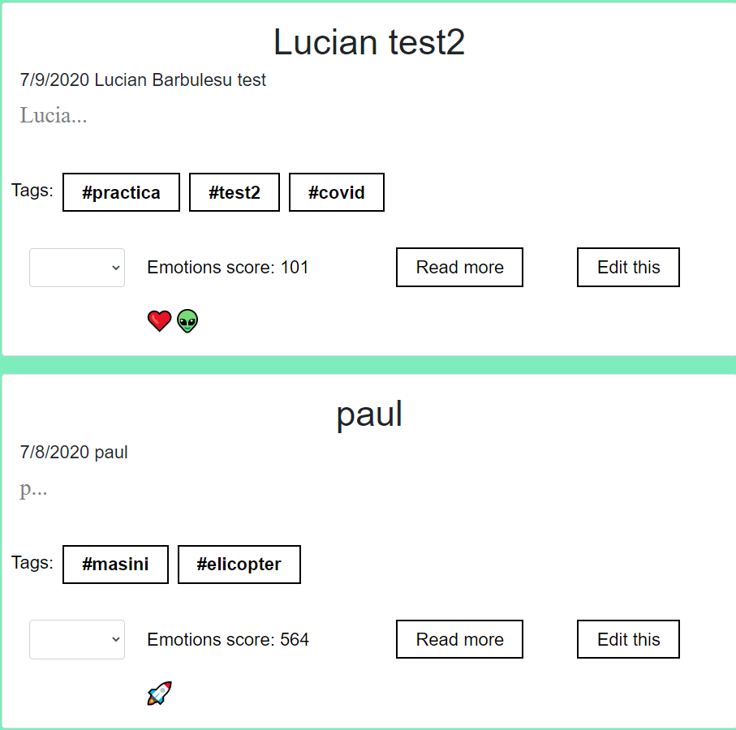
You can vote multiple articles. Emoji’s remains on untill you closed the session and that’s why some posts have bigger score, because you closed the server with some articles with emojis and the score was updated in database. Emoji’s articles are stored in cookies.

Slide 19
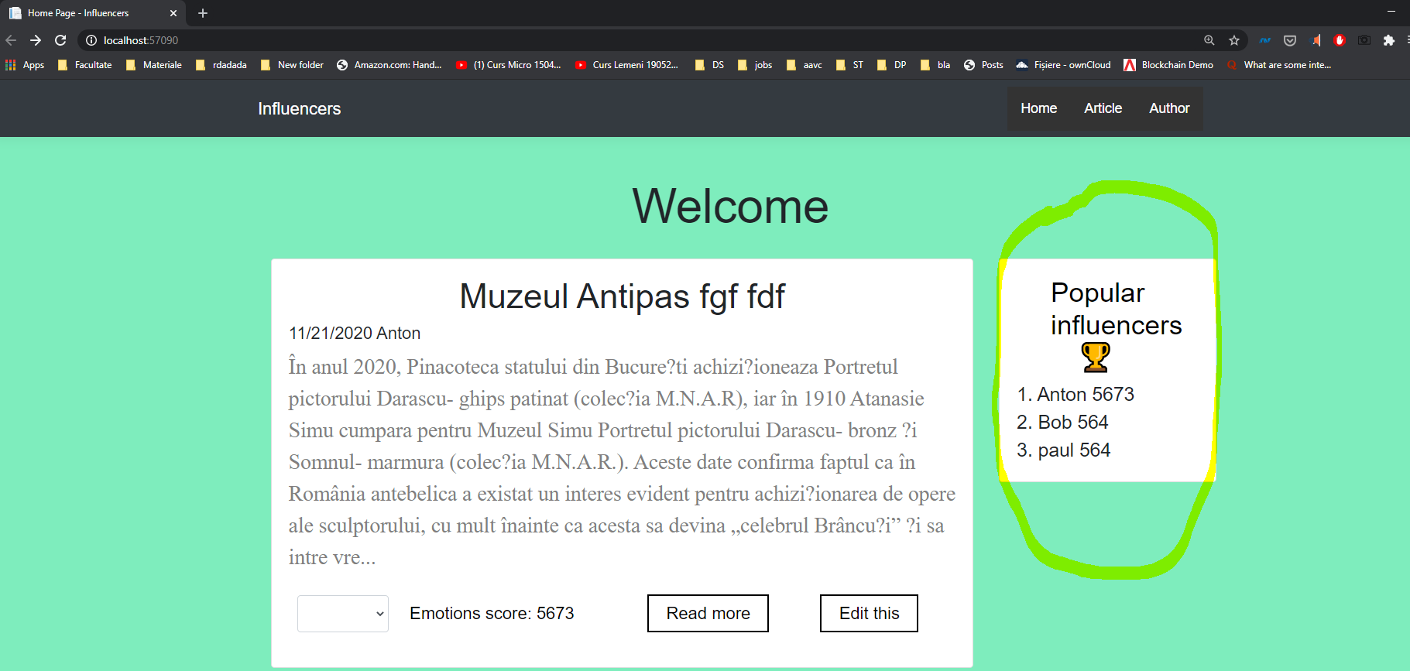
Ranking of authors after emotions score

Slide 20
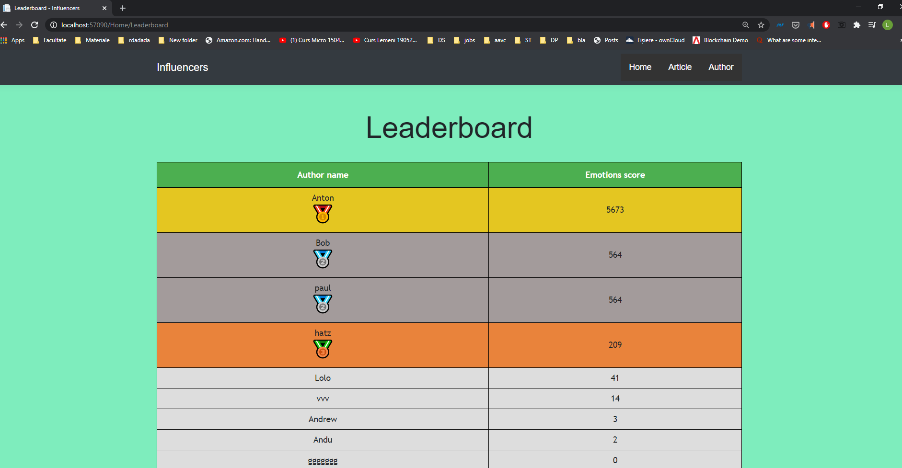
Notice that Bob and paul share silver medal having the same score

Slide 21
The end

